Slide 1

Building and testing variable resolution grids
ESM Lunch Meeting
11-06-2024

Slide 2
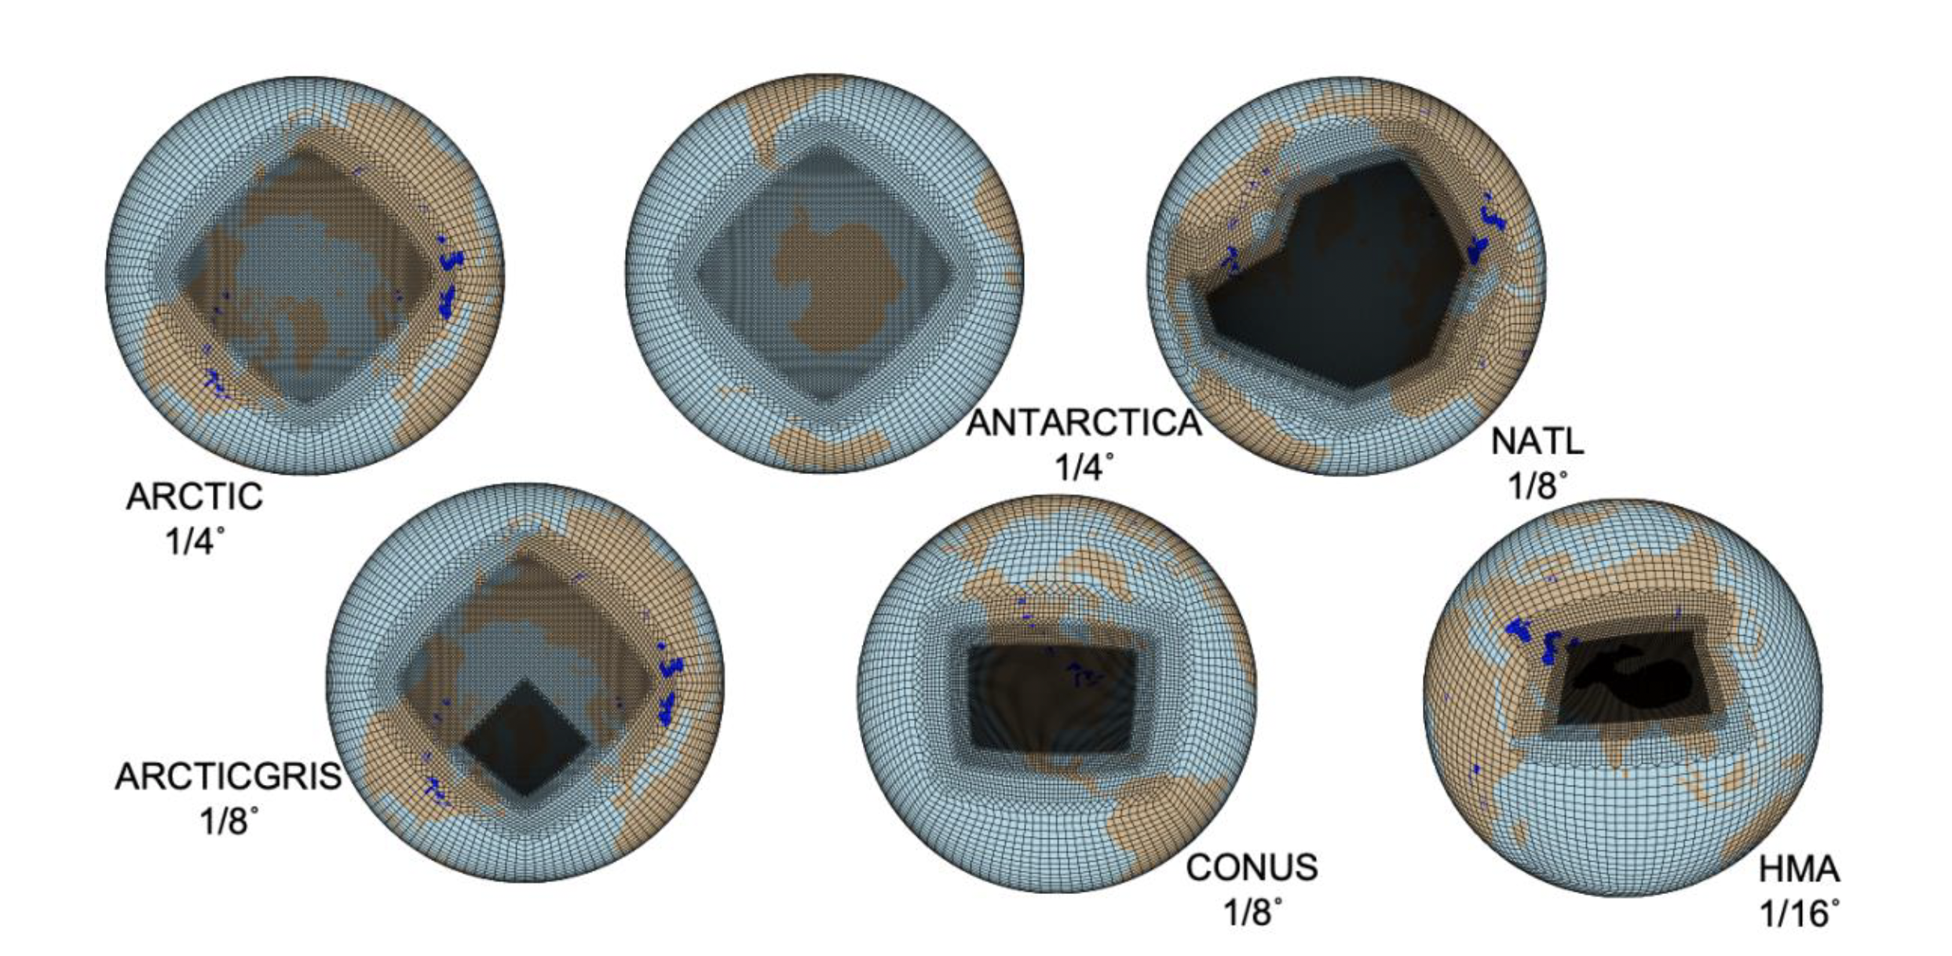
What are variable resolution (VR) grids?
Variable resolution grids are hybrids between RCM grids and GCM grids → includes a regional grid refinement over a region of interest within a coarse-gridded global domain
Source: CESM Science and Strategic Plan: 2023-2028

Slide 3
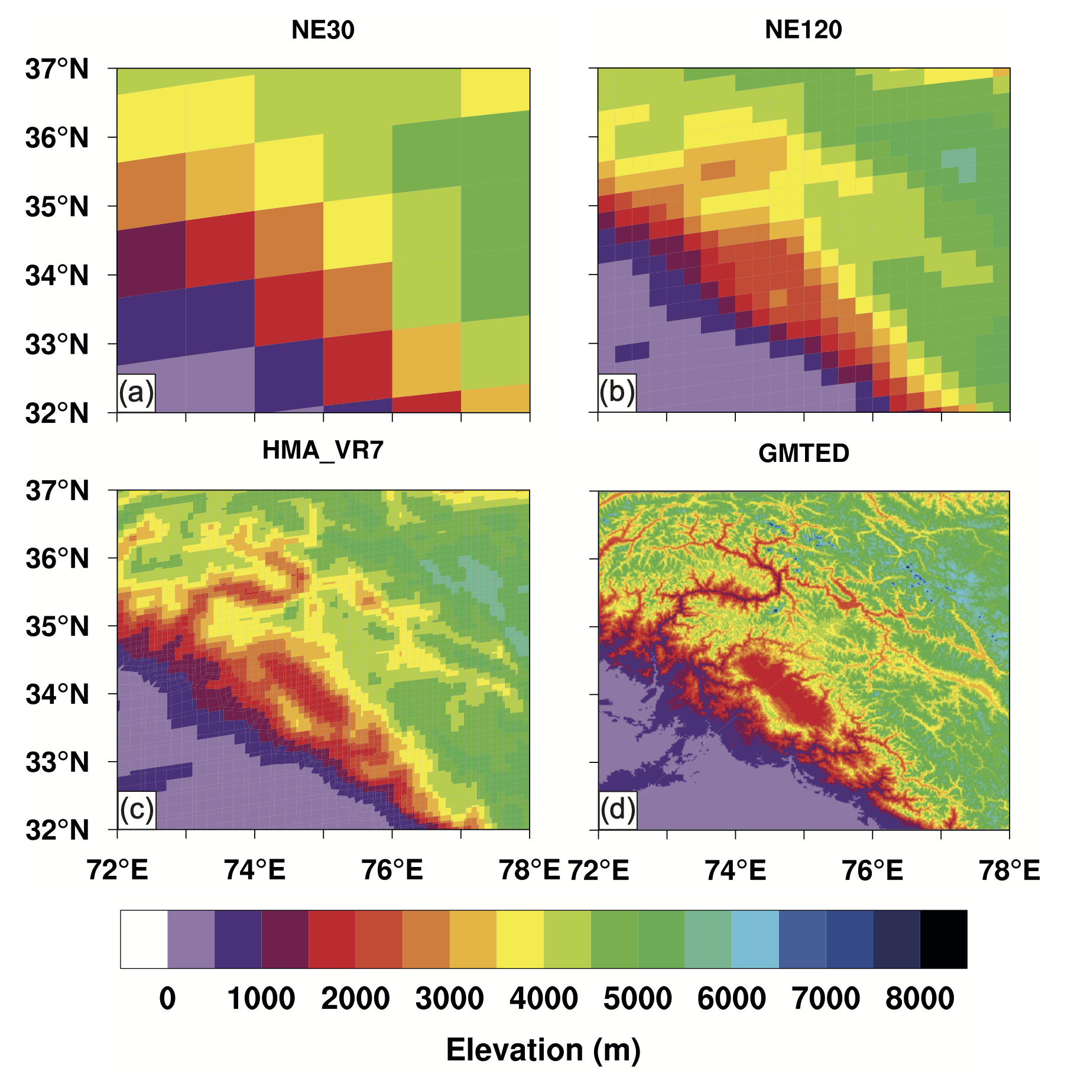
Why VR grids?
NE30 (~111 km)
AMIP-style cost:
2.500 CPU hrs per simulated year.
NE120 (~28 km)
AMIP-style cost:
~100.000 CPU hrs per simulated year.
HMA_VR7 (up to ~7 km)
AMIP-style cost:
90.000 CPU hrs per simulated year.
Source: Wijngaard et al., 2023, TC

Slide 4
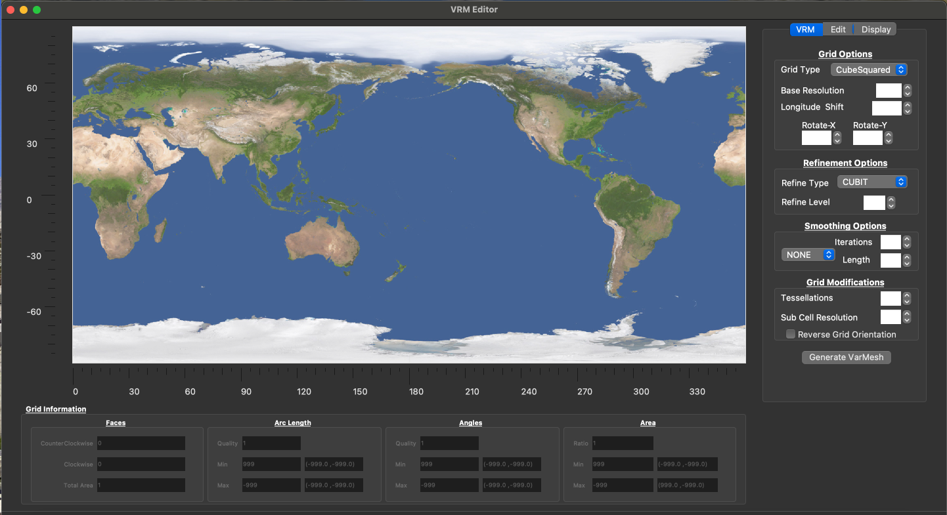
How can we build VR grids nowadays?
Interactive method
VRM Editor
Works via graphical interface
Hybrid method
Combination of command-line
and VRM Editor
Works with NetCDF files
Command-line method
SQuadGen software package
Works via command line
Constructs refinement from black/white PNG file

Slide 5
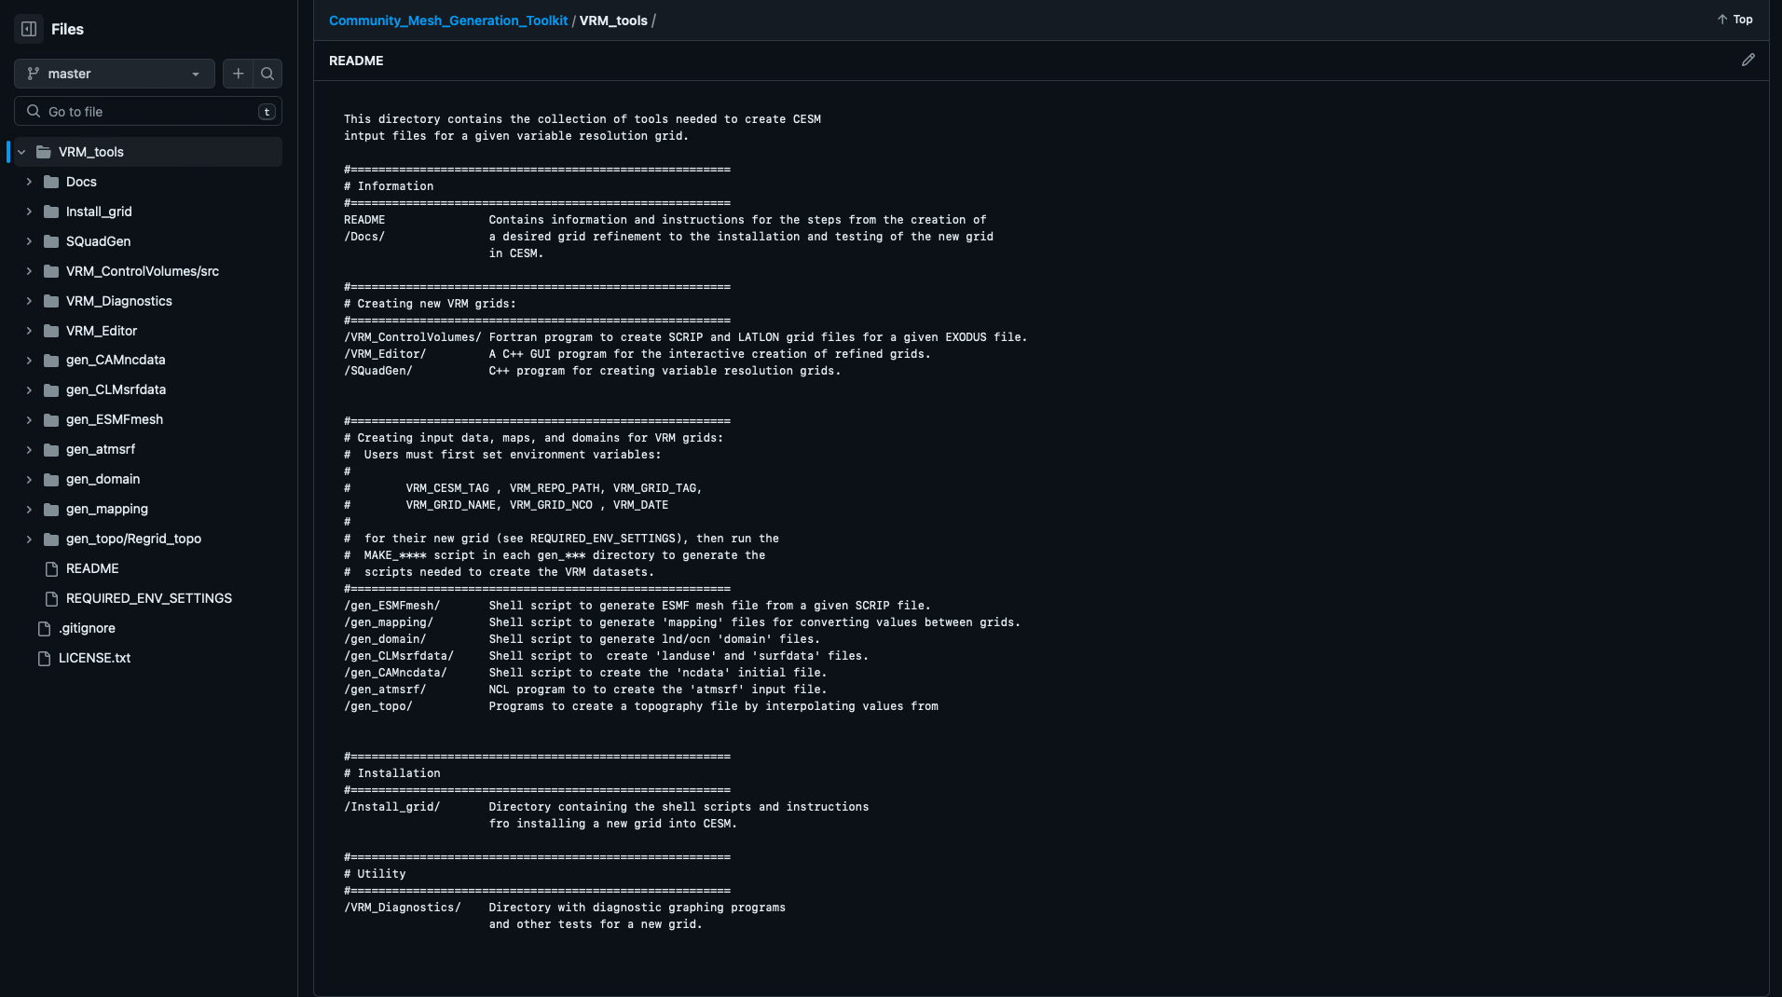
Installing VRM Tools (Community Mesh Generation Toolkit): https://github.com/ESMCI/Community_Mesh_Generation_Toolkit

Slide 6
Use of VRM Editor (Short Demo)

Slide 7
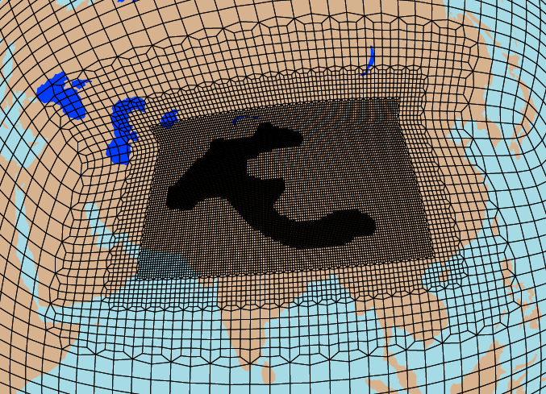
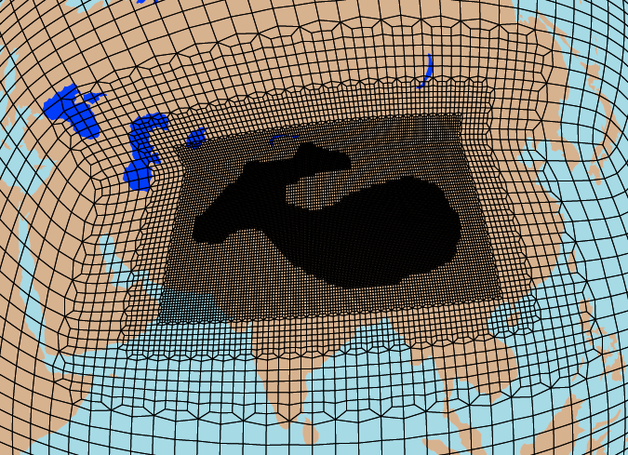
How did I build VR grids? - Design
HMA excl. Tibetan Plateau
HMA incl. Tibetan Plateau

Slide 8
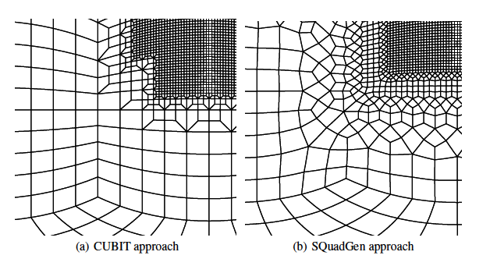
VR Refinement Techniques
Two techniques:
CUBIT (High Connectivity)
Computationally cheaper
Higher node valence → more acute angles and distorted elements → numerically less stable.
Easier for generating grids with irregular refinement boundaries
LOWCONN (Low Connectivity)
Computationally more expensive
Lower node valence
Better numerical stability
Source: Guba et al., 2014, GMD

Slide 9





Building grids with SQuadGen
Making PNG files with QGIS (or other GIS software).
NE60 (~55 km)
NE120 (~28 km)
NE240 (~14 km)
NE480 (~7 km)
Excl TP
NE470 (~7 km)
Incl TP

Slide 10
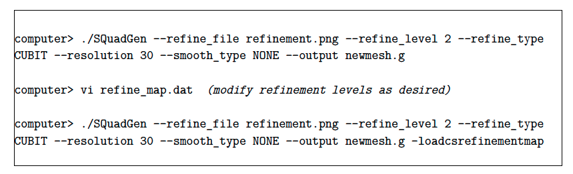
Building grids with SQuadGen
2. Applying SquadGen to generate EXODUS file of VR mesh (iteratively)
./SQuadGen --grid_type "CS" --refine_type "CUBIT" --refine_level 4 --resolution 30 --refine_file "plot_ne30_refinement_hma_incl_tp.png" --smooth_type "SPRING" --smooth_dist 10 --smooth_iter 10 --output "vr_hma_incl_tp_l4.g" --loadcsrefinementmap

Slide 11
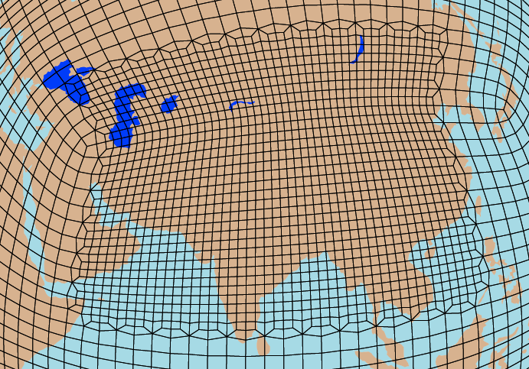
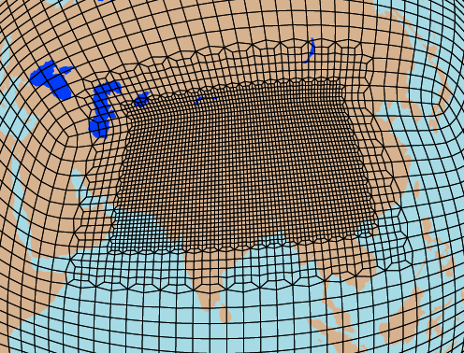
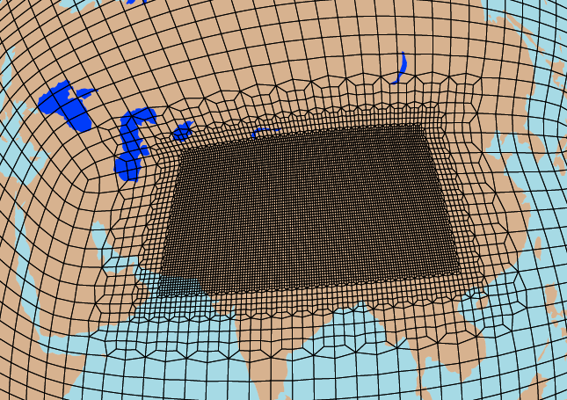
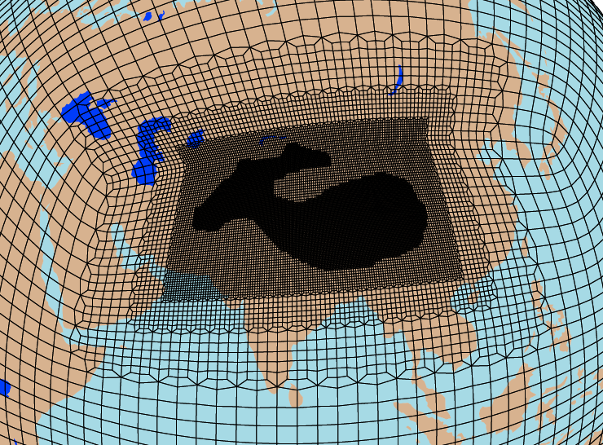
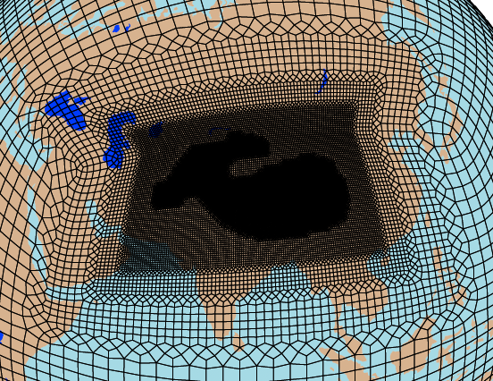
Building grids with SQuadGen
NE60 CUBIT
NE120 CUBIT
NE240 CUBIT
HMAVR7 CUBIT
HMAVR7 LOWCONN

Slide 12
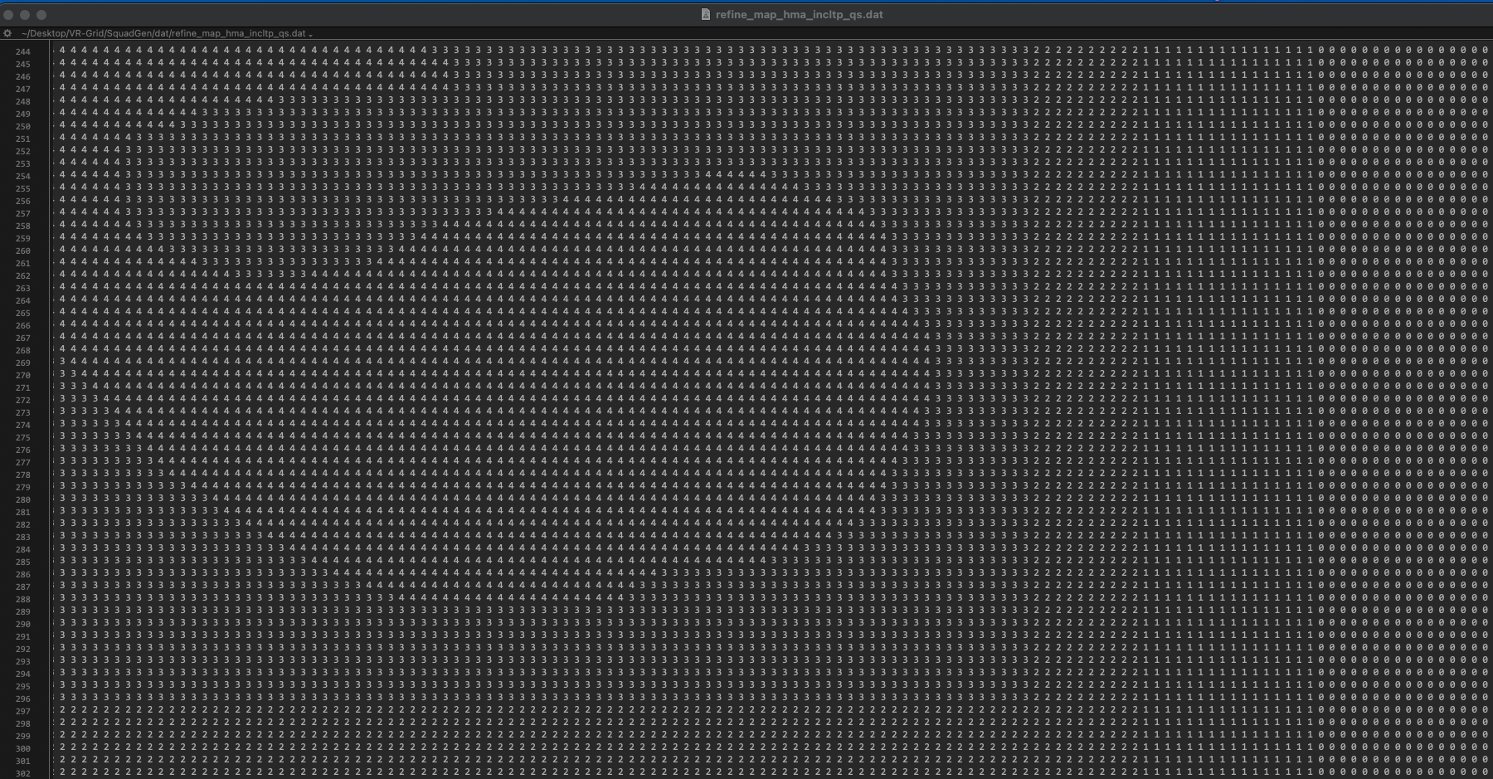
Building grids with SQuadGen
3. Editing VR grid via refine_map.dat

Slide 13
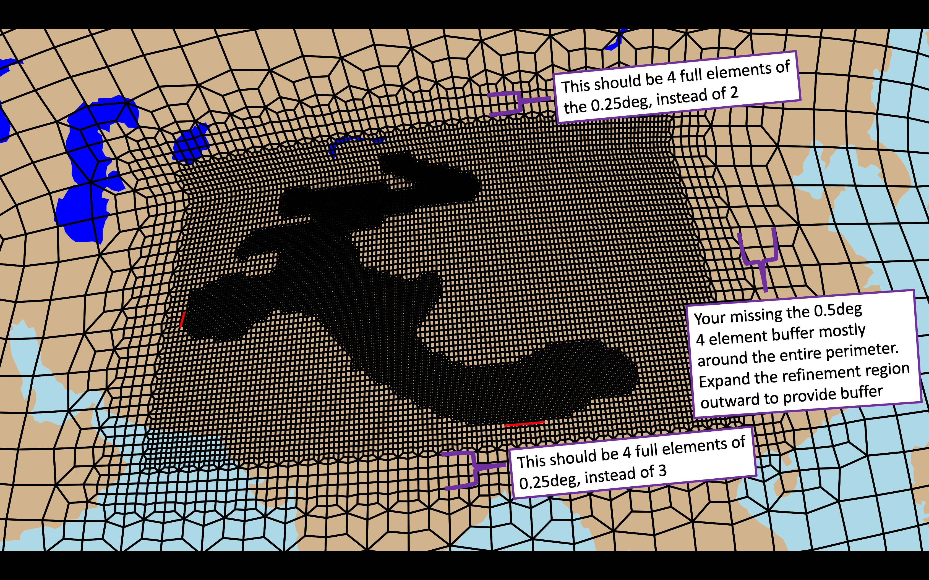
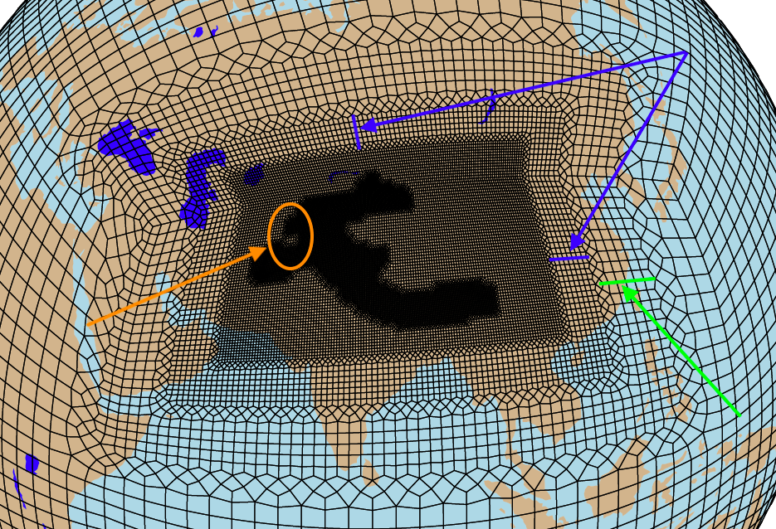
Building grids with SQuadGen
3. Editing VR grid via refine_map.dat
Eliminate areas with risk for distortions
Develop buffer zones of 5 elements around each refined patch

Slide 14
Building grids with SQuadGen
4. Installing VR grid and testing
Generate SCRIP and LATLON files
SCRIP file contains info on position, area and corner points of grid cells
LATLON file contains lat/lon coords and area of grid cells
Generate mapping and lnd/ocn domain files
Generate CLM surface datasets and CAM initial conditions files
Generate topography files with NCAR_Topo
Installing grids in CESM via xml files
Run CESM for 10 days with QPC6 (AquaPlanet) component set.

Slide 15
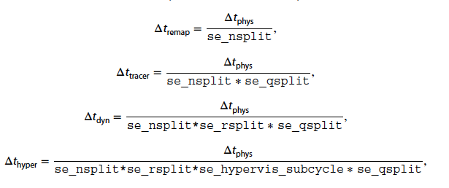
How can we test VR grids?
Testing of grids → Aquaplanet QPC6 Compset
→ Active CAM, Data Ocean, Other Components Stub.
Parameterizing CAM-SE time stepping
→ Balance between computational cost and stability (performance) model runs
Example for 1-deg SE grid (ne30):
dt_{phys} = 1800 s (30 min)
nsplit = 2
rsplit = 3
qsplit = 1
hypervis_subcycle = 3
dt_{dyn} = 300 s
dt_{hyper} = 100 s
Source: Lauritzen et al. 2018, JAMES

Slide 16
Model Timing
GRID | ATM_NSPLIT | nsplit | aqua (1) or usatmos (2) | ndays | total pes | model cost peh/yr | model througput yr/day
HMA-cubit | 384 | 8 | 2 | 3 | 1800 | 141588 | 0,31
 | 800 | 4 | 2 | 3 | 1800 | 176313 | 0,25
 | 800 | 4 | 1 | 3 | 1800 | 179190 | 0,24
 | 384 | 8 | 1 | 3 | 1800 | 145466 | 0,3
HMA-loconn | 384 | 8 | 2 | 3 | 1800 | 159571 | 0,27
 | 800 | 4 | 2 | 3 | 1800 | 179058 | 0,24
 | 800 | 4 | 1 | 3 | 1800 | 203070 | 0,21
 | 384 | 8 | 1 | 3 | 1800 | 161658 | 0,27
HMAnoTP-cubit | 800 | 4 | 1 | 3 | 1800 | 136824 | 0,32
 | 384 | 8 | 1 | 3 | 1800 | 120436 | 0,36
HMAnoTP-loconn | 800 | 4 | 1 | 3 | 1800 | 176013 | 0,25
 | 384 | 8 | 1 | 3 | 1800 | 139867 | 0,31

Slide 17
Model Timing
Parameters | HMAnoTP-C | HMAnoTP-L | HMAnoTP-C | HMAnoTP-L
ATM_NSPLIT (dtphys) | 384 (225s) | 384 (225s) | 384 (225 s) | 384 (225 s)
nsplit | 8 | 8 | 5 | 5
rsplit | 3 | 3 | 3 | 3
qsplit | 1 | 1 | 1 | 1
hypervis_subcycle | 2 | 2 | 9 | 9
dtdyn | 9.4 s | 9.4 s | 15 s | 15 s
Model Cost (pe-hrs/yr) | 106373 | 121836 | 91356 | 104830
Model Throughput (yrs/wday) | 0.81 | 0.71 | 0.95 | 0.82
PES | 3600 | 3600 | 3600 | 3600
Target: dynamical time step of 18.75s → VR28 timestep

Slide 18
Model Timing
Parameters | HMAnoTP-CUBIT | HMAnoTP-LOCONN | HMA-CUBIT*
ATM_NSPLIT (dtphys) | 384 (225 s) | 384 (225 s) | 384 (225 s)
nsplit | 4 | 4 | 4
rsplit | 3 | 3 | 3
qsplit | 1 | 1 | 1
hypervis_subcycle | 3 | 3 | 3
dtdyn | 18.75 s | 18.75 s | 18.75 s
Model Cost (pe-hrs/yr) | 73756 | 78105 | 84892**
Model Throughput (yrs/wday) | 1,17 | 1,11 | 2.18**
PES | 3600 | 3600 | 7680
* Hereafter HMA-hiconn
**Change in CLUBB subcycle parameterization

Slide 19
Take-home links
Youtube tutorial Variable Resolution in CESM: https://www.youtube.com/watch?v=tCbZA9JsD9I&t=437s
CESM Tutorial Variable-Resolution CESM: https://files.cesm.ucar.edu/events/tutorials/5/2023-cesm-tutorial-vr-cesm-adam-herrington.pdf
VR generation toolkit: https://github.com/ESMCI/Community_Mesh_Generation_Toolkit/tree/master
SQuadGen: https://github.com/ClimateGlobalChange/squadgen

